Slide 1



NAME OF THE PROJECT : MULTI CLASS ANIMAL CLASSIFICATION USING AIML
NAME : KAMARAJU SHREYA
AICTE ID : STU668abc091bfe1716038592

Slide 2

LEARNING OBJECTIVES
UNDERSTANDING PROBLEM DOMAIN : Describe what multi class classification is and identify real world applications using ML.
DATA ACQUISITION AND PREPROCESSING : Acquire datasets of animals , images or features and perform data cleaning.
FEATURE ENGINEERING : Extract different features from data.
MODEL SELECTION : Compare different ML algorithms suitable for multi class classification.
HYPERPARAMETER TUNING : Use various techniques to optimize model performance..
MODEL INTERPRETATION AND INSIGHTS : Interpret the results and analyze misclassifications . Understand the limitations and improvements.
MODEL TRAINING AND EVALUATION : Train the chosen models .Use performance metrics like accuracy, precision, recall, F1 score to evaluate.
DEPLOYMENT AND REAL-WORLD USE : Understand the ethical implications and biases that may exist in animal classification models.
DOCUMENTATION AND PRESENTATION : Document the ML workflow clearly present it using visualizations and explain decisions made during development.
GOAL
Source :
www.freepik.com/

Slide 3
Tools and Technology used
Multi-class animal classification refers to the process of identifying and categorizing animals into different classes or species using various tools and technologies. These technologies primarily rely on machine learning, computer vision, and deep learning techniques. Here are the key tools and technologies commonly used for multi-class animal classification:
Decision Trees: Used for classifying animals based on various features like size, color , and habitat.
Random Forest: An ensemble method combining multiple decision trees, commonly used for classification tasks.
Support Vector Machines (SVM): Effective for multi-class classification problems, especially when there are clear boundaries between classes.
k-Nearest Neighbours (k-NN): A non-parametric method that classifies an animal based on the majority class of its nearest neighbours in the feature space.
Tensor Flow / Keras : Deep learning frameworks that make it easier to implement CNN models and perform multi-class animal classification .
GPUs (Graphics Processing Units): Since deep learning models like CNNs require large amounts of computation, GPUs are essential for training large-scale models efficiently.

Slide 4
Methodology
The methodology typically follows a systematic approach that involves data collection, pre-processing, model selection, training, evaluation, and deployment.
Problem Definition: The first is to clearly define the problem. You need to decide whether the classification task is based on images, audio, or other features (e.g., behavioral data).For example species classification.
2. Data Collection: The next step is gathering a labeled dataset that contains images , animals from different classes.
3. Data Pre-processing: Once the dataset is collected, pre-processing is essential for improving model performance.
4. Model Selection: The heart of a multi-class classification project is the selection of the right model. For animal classification, deep learning methods, particularly Convolutional Neural Networks (CNNs), are commonly used due to their effectiveness in image classification tasks.
5. Model Training: In this step, the model is trained using the labeled dataset.
6. Model Evaluation : After training the model, evaluate its performance using the validation set (during training) and the test set (after training).
7. Model Improvement (if necessary):If the model's performance is not satisfactory, consider the following strategies:
Data Augmentation , Ensemble Methods, Advanced Architectures , Fine-tuning is used.
8. Deployment : Once the model is trained and evaluated, the final step is to deploy it to a production environment where it can be used to classify new animal images.

Slide 5
Problem Statement:
How can we develop a machine learning model that accurately classifies images of animals into multiple categories (such as mammals, birds, reptiles, and amphibians) based on visual features, while overcoming challenges like class imbalance, varying image quality, and distinguishing between similar species?
The task is to develop a machine learning-based system capable of automatically classifying images of animals into multiple distinct categories or species. The system should be trained to recognize and categorize animals from a diverse set of classes (such as mammals, birds, reptiles, and amphibians) based on their visual characteristics. The goal is to build a model that can be applied in various real-world scenarios, such as wildlife monitoring, educational tools, and pet identification applications.

Slide 6
Solution:
To solve a multi-class animal classification project, you'll need to follow a structured approach that involves data collection, pre-processing, model selection, training, evaluation, and deployment.
Problem Understanding
Data Collection & Dataset preparation
Data Processing
Model Selection
Model Training
Model Evaluation
Model Improvement
Deployment
Monitoring & Maintenance

Slide 7
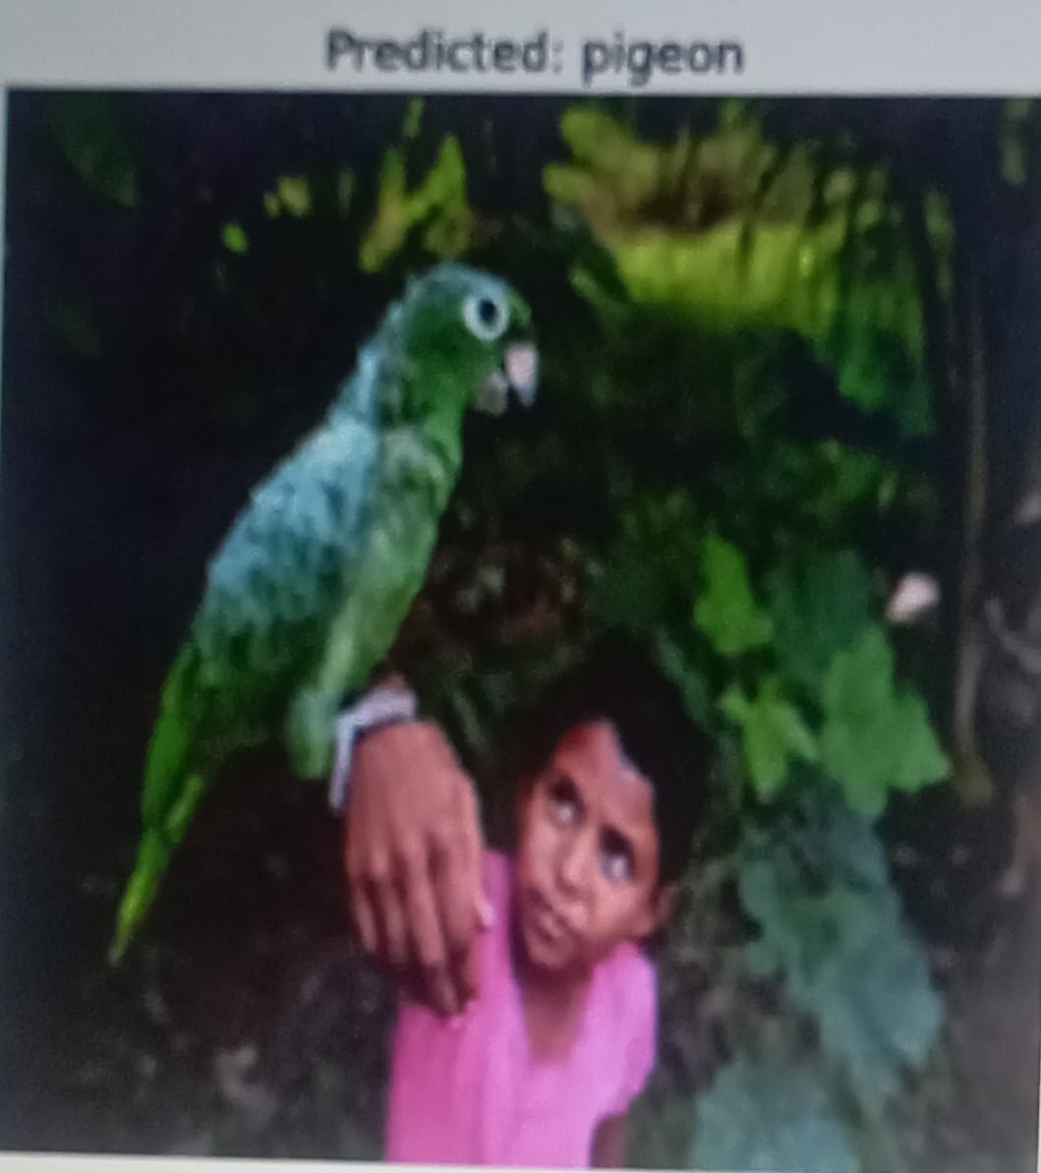
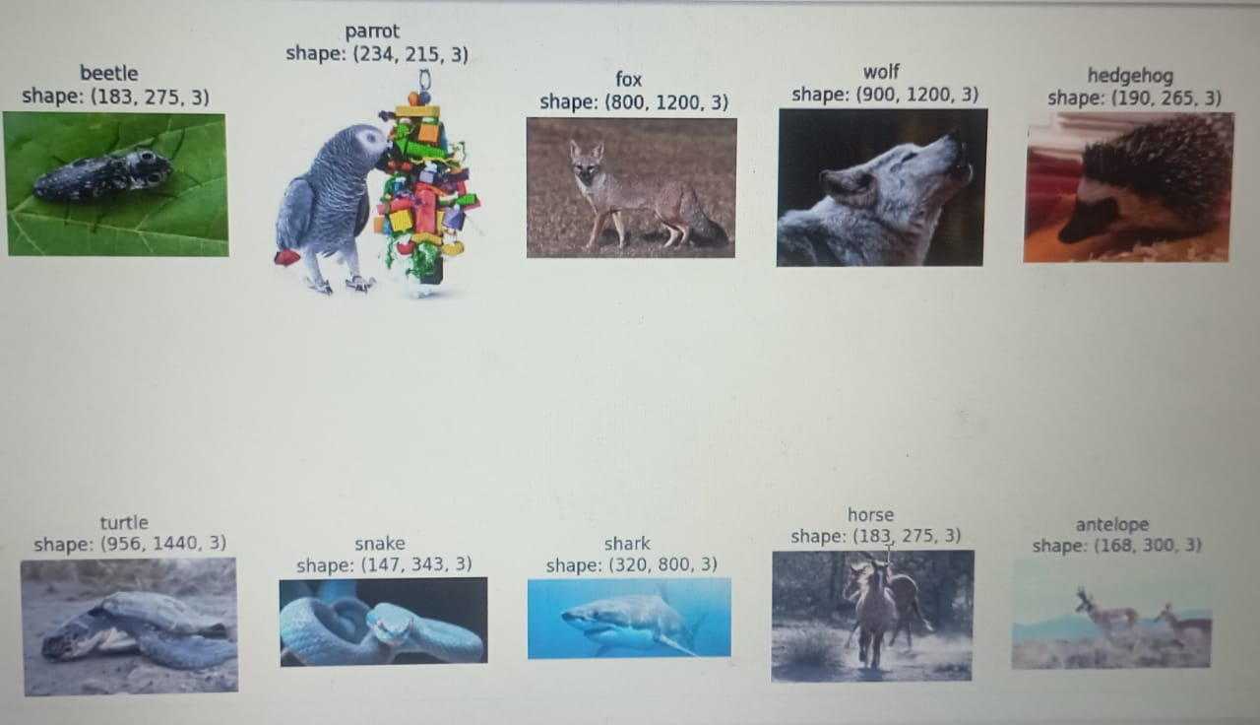
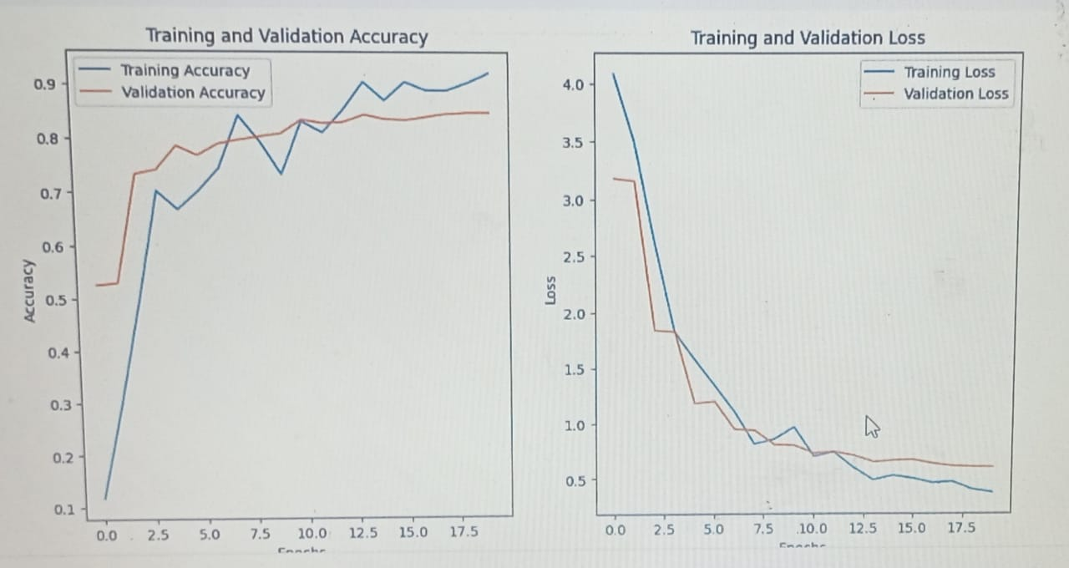
Screenshot of Output:

Slide 8
Conclusion:
In this project, we successfully developed and evaluated a multi-class animal classification model capable of identifying various animal species based on image inputs. Using machine learning techniques—specifically, convolutional neural networks (CNNs)—we trained our model on a diverse dataset, allowing it to learn distinct features for accurate classification. The final model achieved a promising accuracy, demonstrating strong generalization across different animal categories.
It also opens doors for further improvements. Future work may involve expanding the dataset, implementing data augmentation techniques, and experimenting with more advanced architectures like ResNet or EfficientNet to boost performance.
Overall, the project provided valuable insights into the process of building a robust image classification pipeline and showcased the practical applications of AI in wildlife monitoring, conservation efforts, and educational tools.

